Slide 1


HOSPITALITY ANALYSIS
GROUP 3

Slide 2
TOOLS USED
EXCEL
SQL
TABLEAU
POWER BI

Slide 3

OVERVIEW
Hospitality analysis uses data to improve customer experience, optimize operations, and boost revenue in sectors like hotels and travel. Key metrics include ADR (average daily rate), occupancy rate, RevPAR (revenue per available room), and customer satisfaction scores. Techniques like trend analysis, customer segmentation, and predictive analytics help track performance, forecast demand, and personalize services for better decision-making.

Slide 4
PROJECT WORKFLOW/ STEPS
Extract Data/Import Files
Transform Data (Remove Blank And Duplicates)
Manage Relationships
KPI And Visualization
Dashboard

Slide 5
KPI’s
Total Revenue
Occupancy
Cancellation Rate
Total Booking
Utilize Capacity
Trend Analysis
Weekday & Weekend Revenue And Booking
Revenue By State & Hotel
Class Wise Revenue
Checked Out Cancel No Show
Weekly Trend Key Trend (Revenue, Total Booking, Occupancy)

Slide 6
KPI’s TREND ANALYSIS
Overview:
The chart Shows the relationship between the count of total bookings and the average occupancy rate over several weeks.
Key Points:
Total Bookings (Blue Line):
Peaks around weeks 19 and 22 with over 10,000 bookings.
A noticeable decline starting from week 30, dropping to around 1,651 bookings by week 32.
Average Occupancy Rate (Orange Line):
The occupancy rate fluctuates but shows a declining trend from approximately 65% to about 51% towards the end of the period.
Significant drops in occupancy correspond to the decrease in total bookings, particularly noticeable in weeks 30 and 31.
Conclusion:
The data suggests a direct correlation between the number of bookings and occupancy rates. As bookings decline, a corresponding drop in occupancy also occurs, indicating potential challenges in maintaining occupancy levels in the face of fluctuating demand.

Slide 7
SUGGESTIONS
Promotional Campaigns: Launch targeted discounts or packages during low-demand weeks to boost bookings.
Dynamic Pricing: Adjust room rates in real-time based on demand and competitor activity.
Loyalty Programs: Enhance customer retention with rewards for repeat bookings and exclusive offers.
Marketing & Visibility: Strengthen online advertising, social media presence, and travel platform listings.
Competitor Analysis: Monitor competitors' strategies to stay competitive and adapt to market changes.
Demand Monitoring: Prepare for fluctuations by analyzing external factors like seasonality and events.

Slide 8
WEEKDAY & WEEKEND REVENUE AND BOOKING
Overview:
This chart compares revenue and booking statistics for weekdays and weekends, providing insights into overall performance.
Key Points:
Total Bookings:
Weekday Bookings: 84,000
Weekend Bookings: 50,000
Total Revenue:
Weekend Revenue: 1,070 million (M)
Weekday Revenue: 639 million (M)
Comparison:
Bookings: Weekdays outperform weekends in total bookings by 34,000.
Revenue: Despite lower bookings on weekends, weekend revenue is significantly higher.
Conclusion:
Weekdays drive more bookings, while weekends generate greater revenue per booking, indicating potential pricing strategies or customer preferences during those times.

Slide 9
SUGGESTIONS
Leverage Weekend Demand: Maintain premium pricing for weekends, emphasizing value-added services like dining, spa, or event packages.
Boost Weekday Revenue: Offer midweek promotions or corporate discounts to increase average spend per booking.
Customize Marketing: Target business travelers during weekdays and leisure travelers for weekends with tailored offers.
Upsell Opportunities: Promote additional services to weekday guests to close the revenue gap.
Monitor Customer Preferences: Analyze why weekend stays yield higher revenue (e.g., room type, services) and replicate successful elements during weekdays.
Balance Operations: Optimize staffing and inventory to align with weekday and weekend demand patterns.

Slide 10
REVENUE BY STATE & HOTEL
City By Revenue Overview
Mumbai: Leading city with total revenue of ₹669M
Bangalore: Second-highest revenue at ₹420M
Hyderabad: Generates ₹325M in revenue.
Delhi: Lowest among the listed cities with ₹295M.
Key Points-
Mumbai dominates the revenue landscape.
Bangalore, Hyderabad, and Delhi follow, but with significant gaps in revenue compared to Mumbai.
Conclusion
Mumbai is a clear leader in revenue generation, indicating its strong economic position. Other cities show potential but need strategies to enhance their revenues.

Slide 11
SUGGESTIONS
Strengthen Mumbai's Position: Expand premium offerings and maintain competitive pricing to sustain leadership in revenue generation.
Boost Bangalore Revenue: Capitalize on its growing corporate sector by introducing exclusive packages for business travelers.
Leverage Hyderabad's Potential: Promote Hyderabad as a leisure destination with curated cultural and historical experiences.
Address Delhi's Gap: Explore partnerships and marketing campaigns to attract more visitors, focusing on underperforming segments.
Analyze Local Trends: Investigate city-specific preferences and demands to customize services and optimize pricing.
Reallocate Resources: Invest more in marketing and infrastructure in Bangalore, Hyderabad, and Delhi to close the revenue gap with Mumbai.

Slide 12
CLASS WISE REVENUE
Total Revenue by Property and Room Class
Overview of Revenue Generation
Atliq Exotica: Leading with a total revenue of ₹104M, driven by strong performance in all room classes, especially Elite.
Atliq Palace: Close second with ₹99M, significant contributions from both Premium and Elite categories.
Atliq City: Revenue stands at ₹94M, with solid performance across all room classes.
Atliq Blu: Achieved ₹91M in revenue, notably strong in the Premium category.
Atliq Bay: Generated ₹80M, with a steady demand for Standard and Premium rooms.
Atliq Grands: Total revenue of ₹38M, struggling in Standard categories.
Atliq Seasons: Lowest at ₹22M, indicating a need for strategic improvement.
Conclusion
The Elite Room Class is the strongest revenue driver across the properties.
Atliq Exotica and Atliq Palace stand out as top performers.
Atliq Seasons shows potential for growth, requiring targeted strategies for improvement in revenue generation.

Slide 13
SUGGETSTIONS
Maximize Elite-Class Potential: Focus on premium services and marketing for Elite rooms at all properties, particularly top performers.
Boost Standard Room Demand: Introduce competitive pricing or value-added packages to attract customers to underperforming categories like Standard rooms.
Invest in Atliq Seasons: Revamp offerings or reposition Atliq Seasons to target niche markets (e.g., budget travelers or extended stays).
Enhance Atliq Grands Performance: Explore partnerships, local promotions, or bundled deals to improve occupancy and revenue for Standard rooms.
Capitalize on Exotica & Palace: Maintain their leadership by upselling luxury experiences and solidifying their brand reputation.
Class-Based Strategies: Use data-driven insights to refine pricing and promotions tailored to each room class across properties.

Slide 14
CHECKED OUT, CANCEL & NO SHOW
Overview of Revenue Based on Guest Status
Cancelled Reservations:
Atliq Exotica: Highest cancellation rate at 12.30%.
Atliq Palace: Close behind at 12.28%.
Other properties show lower cancellation rates, with Atliq Seasons at 0.73% being the lowest.
Checked Out:
Atliq Exotica leads with 12.30% of revenue from checkouts.
Atliq Palace and Atliq City follow closely, showcasing a strong overall performance.
Atliq Seasons lags at 2.09%, indicating lower revenue generation from checked-out guests.
No Shows:
Atliq Exotica: Slightly better performance at 0.87%.
Majority of properties have low no-show rates, with Atliq Seasons at 0.14%, reflecting minimal impact from guests not arriving.
Conclusion
Atliq Exotica and Atliq Palace show high revenue from cancelled and checked-out reservations, indicating strong demand.
Atliq Seasons presents challenges, particularly in cancellation and checked-out revenues, warranting strategic attention to enhance guest arrivals and bookings.

Slide 15
SUGGESTIONS
Reduce Cancellations: Introduce stricter cancellation policies or incentives for confirmed bookings at Exotica and Palace.
Enhance Guest Experience at Seasons: Improve amenities, promotions, and local partnerships to attract more guests and boost checkouts.
Monitor Demand Trends: Analyze why cancellations are high at Exotica and Palace despite strong demand; adjust pricing or booking terms.
Promote Flexible Policies: Offer flexible rescheduling options to mitigate cancellations while retaining revenue potential.
Capitalize on Low No-Shows: Highlight the low no-show reliability in marketing to attract group or corporate bookings.
Target Underperforming Properties: Allocate marketing and operational efforts to improve Atliq Seasons’ overall performance.

Slide 16
CREATIONS
Total revenue – 1709M
Occupancy – 58%
Cancellation rate – 25%
Total booking – 134.59k
Utilize capacity -- 70%

Slide 17
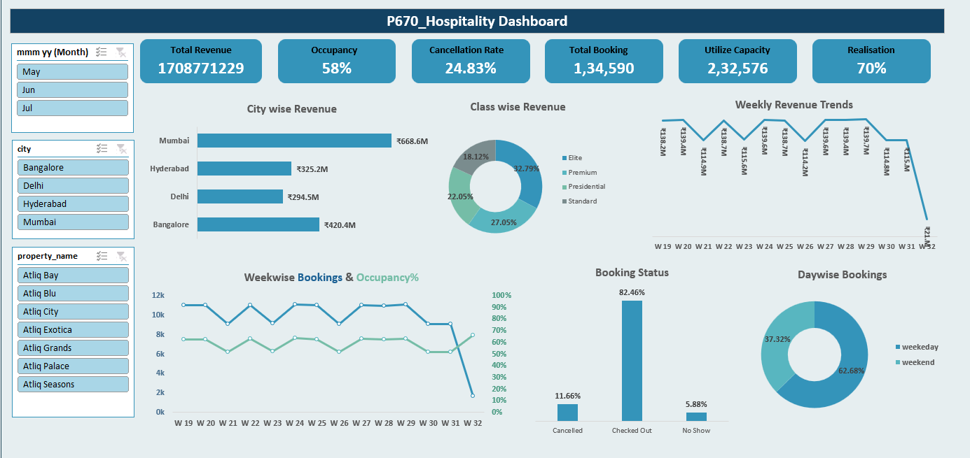
EXCEL DASHBOARD

Slide 18
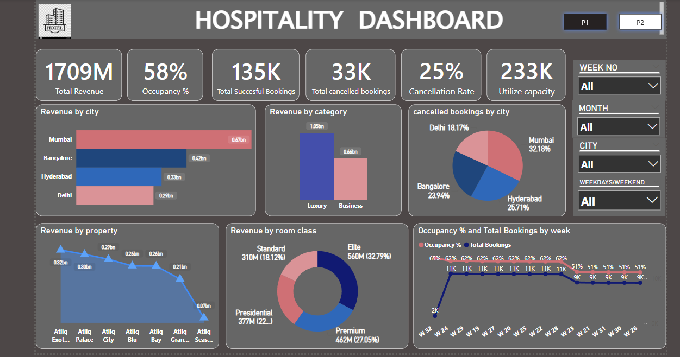
POWER BI DASHBOARD

Slide 19
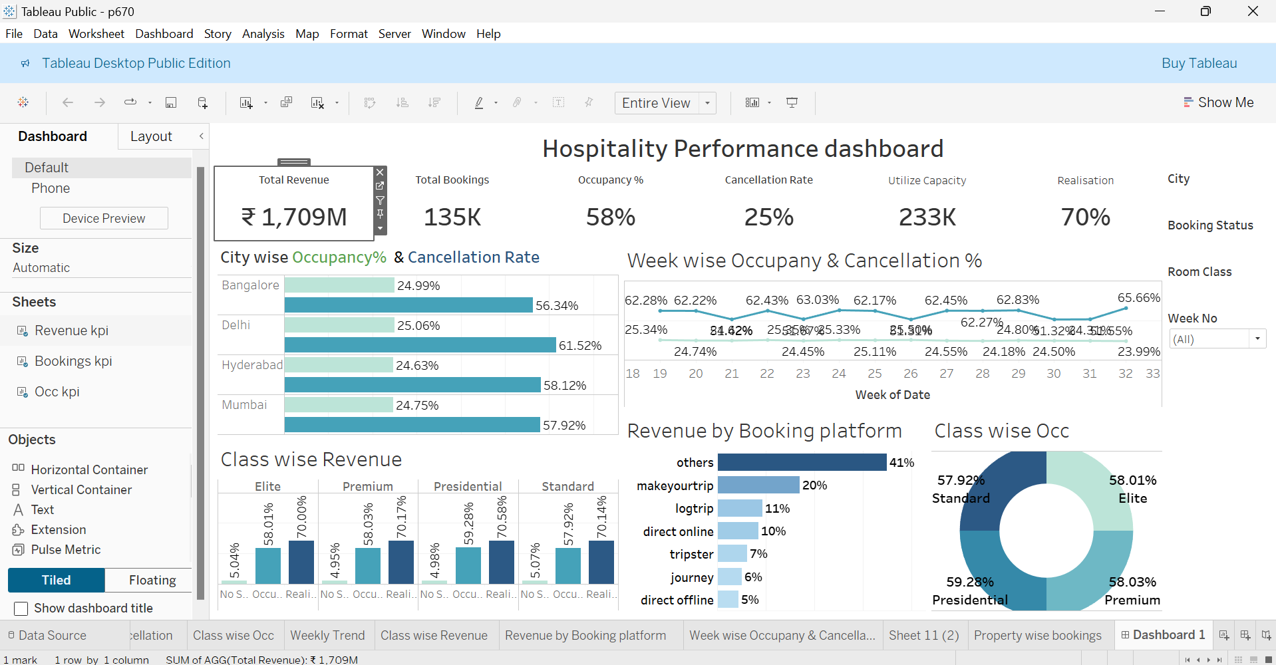
TABLEAU DASHBOARD

Slide 20
THANK YOU

